Slide 1
Digital Portfolio
STUDENT NAME: THAMIZHARASAN.K
REGISTER NO AND NMID: 222407666/1453222407666
DEPARTMENT: BSC.CS
COLLEGE: COLLEGE/ UNIVERSITY VELTECH RANGA SANKU ARTS COLLEGE/MADRAS UNIVERSITY

Slide 2
PROJECT TITLE
DIGITAL PORTFOLIO

Slide 3


AGENDA
Problem Statement
Project Overview
End Users
Tools and Technologies
Portfolio design and Layout
Features and Functionality
Results and Screenshots
Conclusion
Github Link
3/21/2024 Annual Review

Slide 4
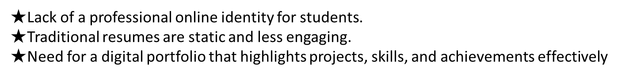

PROBLEM STATEMENT

Slide 5


PROJECT OVERVIEW

Slide 6
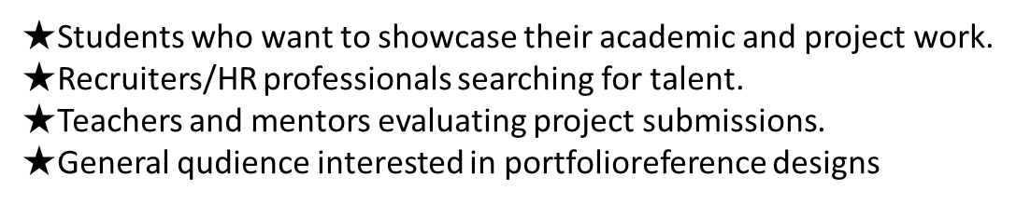

WHO ARE THE END USERS?

Slide 7
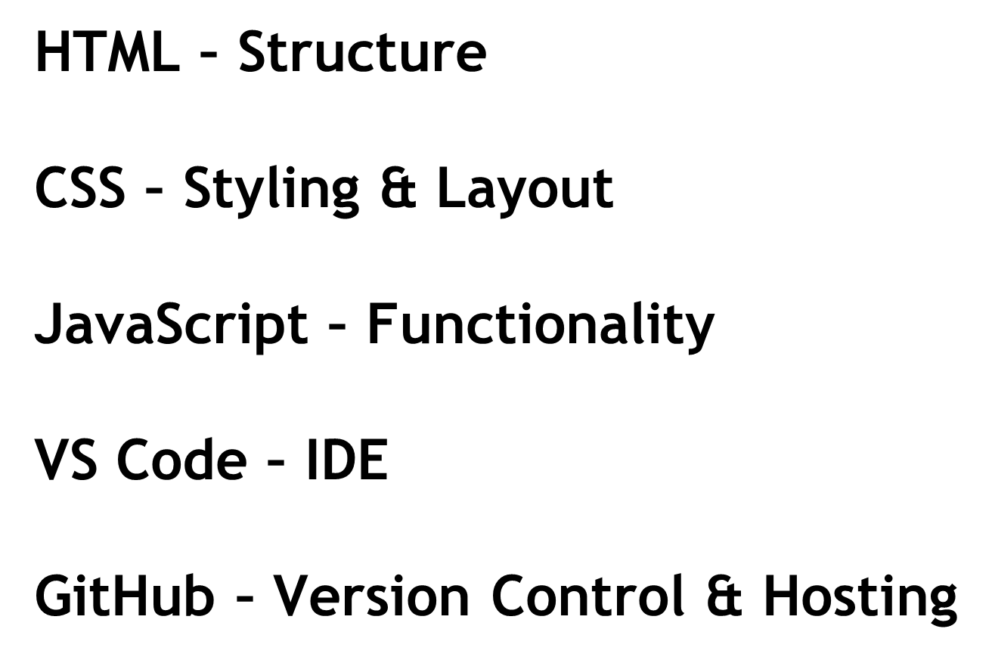

TOOLS AND TECHNIQUES

Slide 8
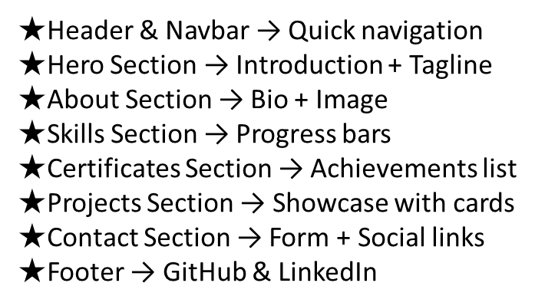
POTFOLIO DESIGN AND LAYOUT
8

Slide 9
FEATURES AND FUNCTIONALITY
★ Responsive navigation bar mobile and desktop view).Dark mode toggle Interactive skill progress bars. ★Contact form with validation & success message Project showcase using cards with hover effects.Social links for networking (GitHubLI & Linkedln)

Slide 10
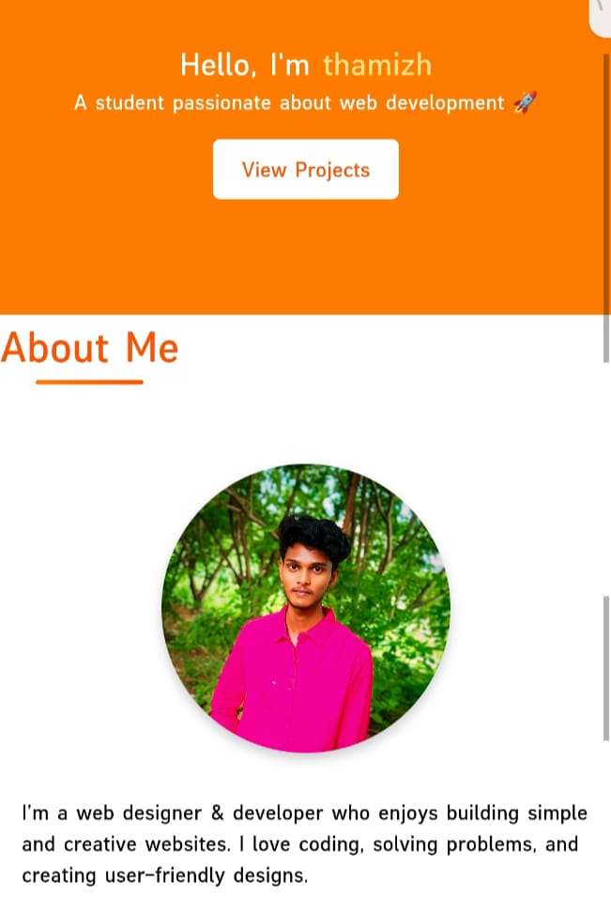
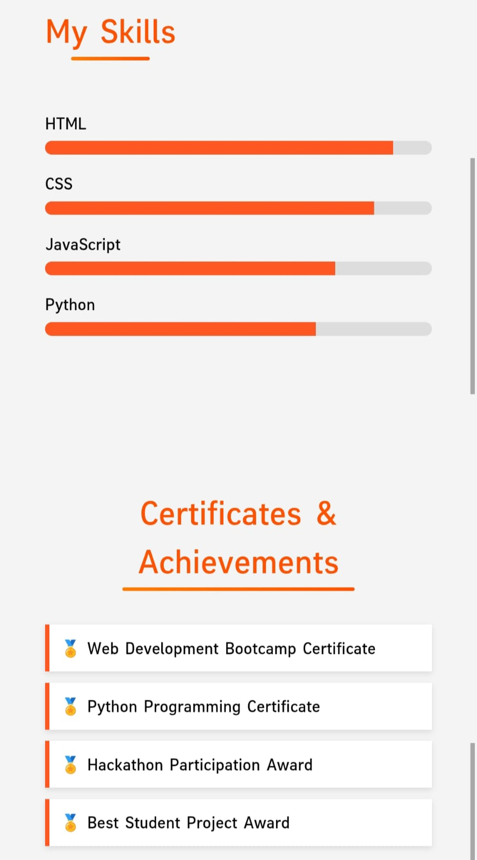
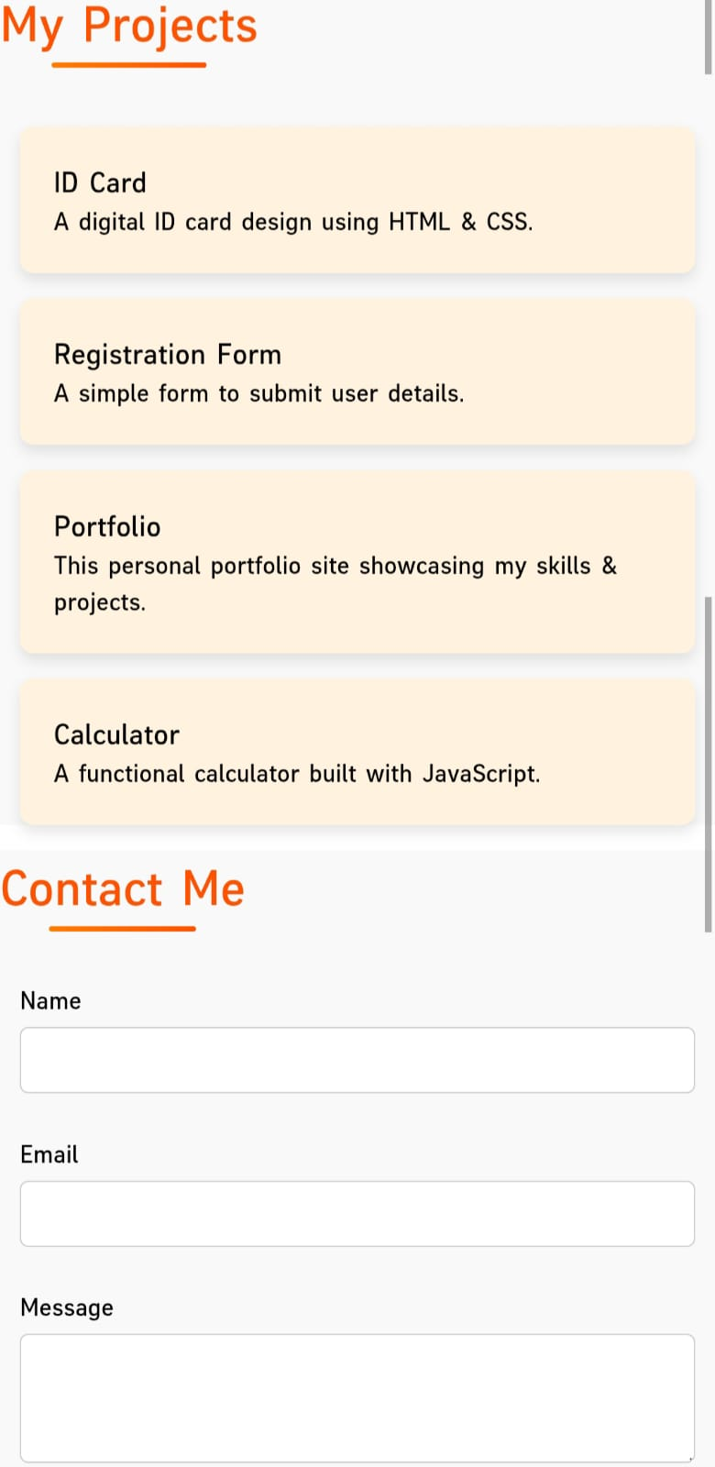

RESULTS AND SCREENSHOTS
3/21/2024 Annual Review
10

Slide 11

CONCLUSION
11

